Slide 1
Basics of SQL Execution Plans and Performance Tuning
Presented by : Nikhil Bhardwaj

Slide 2
Topics of Discussion
Identifying performance bottlenecks
Available resources to boost query performance
A brief revisit of Indexes and Statistics
Execution plans
Query tuning tips.

Slide 3
Session Details
Easy Introduction To:
Performance bottlenecks and tools to identify them
Indexes and statistics
Why execution plans are important
How executions plans are created
Learn about different type of execution plans
Learn the difference between estimated and actual execution plans
Learn different ways to capture execution plans
Learn the basics of how to read & interpret graphical execution plans.

Slide 4
Major Performance Bottlenecks
Any performance problem is identified by a report/application running slow. The cause can be any of the following :-
Resource bottlenecks
CPU
Memory
IO
TempDB bottlenecks
Slow running user query.

Slide 5
Tools For Identifying Problem Area
Most important part of resolving performance issues is to pinpoint the real pain area. Some of the methods to do that are:-
Performance Monitor
SQL Server Profiler
DMVs
DBCC Commands.

Slide 6
Available Resources For Tuning Query Performance
Indexes
Can play a major role in boosting up query performance
Database Engine Tuning Advisor
An off-the-shelf tool provided by MS to give tuning recommendations
Execution Plan (Our topic of discussion today)
Capturing Query Execution Statistics.

Slide 7
Indexes – Brief Overview
Clustered
Store Actual data
Data is logically and physically ordered
Only one clustered index in a table
Non-clustered
Contains only keys and pointers to the actual data
Table may have multiple non-clustered indexes
Non-clustered index can be covering.

Slide 8
Statistics – Brief Overview
Statistics for query optimization are objects that contain statistical information about the distribution of values in one or more columns of a table or indexed view.
The query optimizer uses these statistics to estimate the cardinality, or number of rows, in the query result.
Stored in the form of histograms
Sometimes statistics may become outdated
Sometimes additional statistics may be required.

Slide 9
Execution Plans
Execution Plan Defined:
An execution plan, simply put, is the result of the query optimizer's attempt to calculate the most efficient way to imple­ment the request represented by the T-SQL query you sub­mitted
So why is this important to know?
Because you want to answer these questions:
Why are my queries running slow, and what can I do to boost their performance?
Has the query optimizer made a mistake?
Are there missing indexes?
Does the query optimizer have bad data (index and column statistics)?
Is too much data being returned?
Is the query poorly written?

Slide 10
How Execution Plans are Created?
A “new” query is sent to the query optimizer
The query is parsed to check if it is written correctly
The query then goes through a binding process, where validation steps occur, which resolves all the names of the various objects, tables and columns, among other tasks
The query then goes through the optimization process, where different execution plans are explored, and then one is selected based on the lowest cost (generally)
Then the query is executed by the query execution engine.

Slide 11
How Execution Plans are Created contd..
Bind
Optimize
Parse
Execute

Slide 12
More on the Execution Plan Process
DDL code is not optimized, because there is only one way to perform such tasks
Some queries have such an obvious execution plan that a trivial plan is created, as the query doesn’t need to be optimized
If a trivial plan is not appropriate, then a full optimization process begins
In some cases, all potential execution plans are analyzed, and the least cost one is selected
In other cases, a good enough plan is selected – WHY?
The creation of an optimized execution plan takes time. That’s why execution plans are placed in the plan cache, and SQL Server tries to reuse them when possible.

Slide 13
Execution Plans Are Cached
Once an execution plan has been created for a query, it is generally stored in the plan cache, where it can hopefully be reused
Reusing a cached execution plan can save time because a new execution plan does not have to be recreated each time the same query is executed
Plan caching and recompilation can significantly affect the performance of a server, and needs serious consideration of its own.

Slide 14
Parameter Sniffing
Parameter values passed for the 1st execution after the compilation/recompilation of a SP are “SNIFFED”
Sniffed values are used for CARDINALITY ESTIMATION
The execution plan for the SP is optimized according to the SNIFFED parameters

Slide 15
Parameter Sniffing
Why Should It Be A Problem For Me?
Consider the below procedure:
create procedure dbo.SearchProducts @Keyword varchar(100)
As
Begin
select *
from Products
where Keyword like @Keyword
End

Slide 16
Parameter Sniffing
First Execution(Atypical) | Typical Execution
EXEC dbo.SearchProducts @Keyword = 'Sony%‘ Highly Selective Rows returned: 10 Index Seek + Key Lookup Very Effective | EXEC dbo.SearchProducts @Keyword = ‘%S%‘ Low Selectivity Rows Returned: 100000+ Effective execution plan: Table Scan The plan which is used: Index Seek + Key Lookup

Slide 17
Execution Plans Come in Different Forms
Text (Deprecated)
Harder for some people to read, but some DBAs prefer it
Because it is text, large plans can be easily searched for “text” strings
XML (A Storage Format)
Executions plans are stored as XML code
XML code is not really designed to be read directly by DBAs
Can be saved and shared with others (makes execution plans portable)
Graphical (A Display Format)
Is the graphical (visual) form of the XML execution plan (see above)
Generally easier to read and understand by beginners than text or XML
Our focus today.

Slide 18
Actual vs. Estimated Execution Plans
Actual Execution Plan
Produced after a query actually runs
Displays a combination of estimated and actual results
Estimated Execution Plan
Produced without running the query
Estimated execution plans have some disadvantages:
Can’t be used if the query creates objects it needs to use: i.e. temp table
Displays estimated data only (based on existing index and column statistics)
Will not reflect parallel query plans correctly
Not guaranteed to represent actual query plan. For example, the optimizer might force a statistics update when a query is executed, which might change the actual plan substantially.

Slide 19
Actual vs. Estimated Execution Plans
Why use an estimated execution plan?
Can save time and resources when testing long running queries
Allows you to explore data modification queries without modifying data.

Slide 20
How to Capture/Produce Execution Plans
SSMS (our choice for today)
DMVs (requires some fancy queries)
SET commands.

Slide 21
How to Read Graphical Execution Plans - DEMO
Overview of Graphical Execution Plan Screen
Using the Zoom Button (Around, In, Out, Fit)
Learning to Read from Right to Left and Top to Bottom
Learning about Operators
Learning about Tool Tips (and Properties)
Learning about Arrows
Executing Multiple Queries.

Slide 22
Execution Plans are Made Up of Operators
Each operator receives rows, performs some operation on them, then sends the rows to another operator
For example:
Scanning data from a table
Seeking data from a table
Sorting
Joining
In total, there are 79 different operators that can be included in an execution plan.

Slide 23
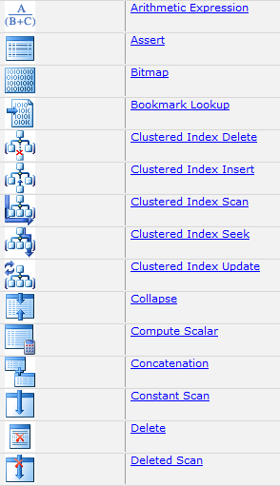
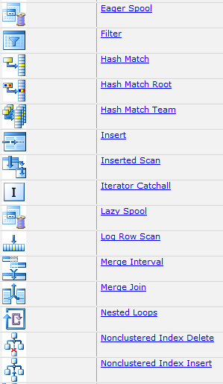
Graphical Execution Plan Operators

Slide 24
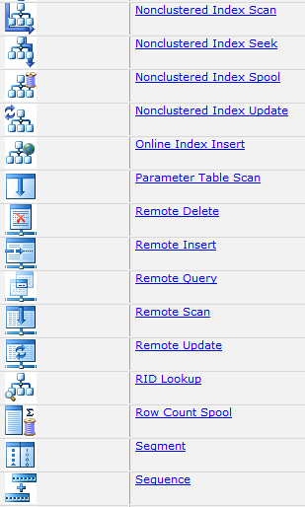
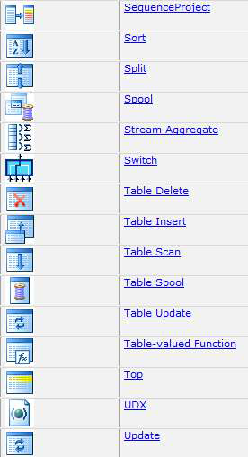
Graphical Execution Plan Operators

Slide 25
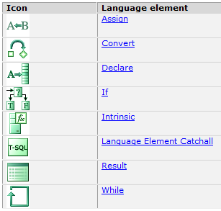
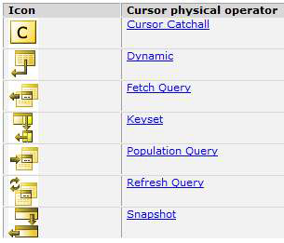
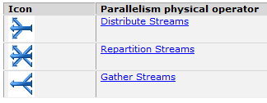
Graphical Execution Plan Operators

Slide 26
Operators Covered
SELECT
Table Scan
Clustered Index Scan
Clustered Index Seek
Non-Clustered Scan
Non-Clustered Index Seek
RID Lookup
Key Lookup
Sort
Joins (loop, merge, hash).

Slide 27

SELECT
Represents the end results of a SELECT query.
Specifies the type of optimization done on the query.
Good place to start when evaluating most execution plans.
To optimize performance, the number of rows that are returned should be the minimum number of rows necessary to meet the needs of the query.

Slide 28

Table Scan
A table scan indicates there is no clustered index on the table, and the table is a heap
A table scan indicates that every row in the table (heap) had to be examined to see if it met the query criteria, which can mean slow performance if there are a large numbers of rows
Generally, heaps should be avoided
In most cases, you will want to add a clustered index to every table, as it has the potential of boosting the performance of the query, even if a clustered index scan is still conducted. This is because leaf nodes of the clustered index are stored together (logically, and hopefully physically). In a heap, they may or may not be, which can hurt performance, as scans work better if data is contiguous on disk.

Slide 29

Clustered Index Scan
A clustered index scan is a scan of the rows of a table that has a clustered index.
Like a table scan, clustered index scans can be slow and use up lots of server resources (for large tables)
Clustered index scans are almost always better than table scans
If you see a clustered index scan, you should investigate to see why it is occurring. It is a hint that a query may be having performance problems. Perhaps the WHERE clause is not restrictive enough
On some occasions, when tables are small or many rows are returned, then a clustered index scan might be the fastest way to return data, so they are not always bad for performance.

Slide 30

Clustered Index Seek
If there is an available and useful index, and there is a sargeable WHERE clause, the query optimizer can very quickly identify the rows to be returned and return them without having to scan each row of the table
Generally speaking, if you see a clustered index seek in an execution plan, this is a good thing
One possible exception to this is if the clustered index seek is repeated over and over again. Check the operator’s “Number of Executions” to find out.

Slide 31

Non-Clustered Index Scan
Rows in a non-clustered index are scanned, and all rows that match the WHERE clause are returned
As with all scans, it can be slow and require extra I/O resources
Generally, seeing a non-clustered index scans should be seen as a hint of potential performance problems
Sometime, these scans can be turned into seeks if you modify the WHERE clause so that it is more restrictive or is sargeable.

Slide 32

Non-Clustered Index Seek
A non-clustered index is used to identify exactly which row(s) are to be returned, so every row does not need to be scanned (assumes sargeable WHERE clause)
This is generally much faster than a non-clustered index scan
Like clustered index seeks, non-clustered index seeks are generally a good thing
One exception is if bookmark lookups occur as part of the non-clustered index.

Slide 33

RID Lookup
A RID Lookup is a form of a bookmark lookup on a non-clustered index on a table without a clustered index(a heap)
If you see a RID Lookup, this is a strong hint of potential performance problems
Generally, RID Lookups should be eliminated with the addition of an appropriate clustered index, and if necessary, a covering index.

Slide 34

Key Lookup
A key lookup is a bookmark lookup on a table with a clustered index
While key lookups are often faster than “scans,” this is not always the case. If the query returns a small number of rows, a key lookup is probably OK
But if many rows are returned, then it may cause a performance problem that needs correction
Often, key lookups can be eliminated with the addition of a covering index.

Slide 35

Sort
Sorts occur when you specify that returned data be ordered, or because the query optimizer needs to sort data internally to produce the desired results
Sorts are normal and aren’t generally a problem
But if you return too much data, then sorts may take a lot of resources (including tempdb), and you should identify ways of reducing the number of rows returned to boost query performance.

Slide 36



Joins (loop, merge, hash)
The nested loop join compares each row from one table (the “outer table”) to each row from the other table (the “inner table”), looking for rows that satisfy the join predicate.
The merge join works by simultaneously reading and comparing the two sorted inputs one row at a time. For each step, it compares the next row from each input. If the rows are equal, it outputs a joined row and continues. If the rows are not equal, it discards the lesser of the two inputs and continues.
The hash join algorithm executes in two phases known as the “build” and “probe” phases. During the build phase, it reads all rows from the first input, hashes the rows on the equijoin keys, and creates or builds an in-memory hash table. During the probe phase, it reads all rows from the second input (often called the right or probe input), hashes these rows on the same equijoin keys, and looks or probes for matching rows in the hash table.

Slide 37
Joins
There is no “ideal join,” it all depends on the data being joined
From a resource perspective, a nested loop join generally uses fewer resources, and seeing one generally is often an indicator of good overall performance. Usually best for smaller joins. No extra memory needed & non-blocking
Merge joins are often used for moderate to large data sets, and are most efficient if the joined columns are pre-sorted, otherwise they have to be sorted before the merge join can occur. If a sort is required, extra memory is required, but it is non-blocking
Hash joins are often used when very large data sets are used. Hash joins parallelize and scale better than other joins and are good at minimizing response times for OLAP queries. They use much memory and can cause blocking. Seeing one may be a hint that too much data is being returned, especially in OLTP applications.

Slide 38
QUESTIONS??

